Slide 1

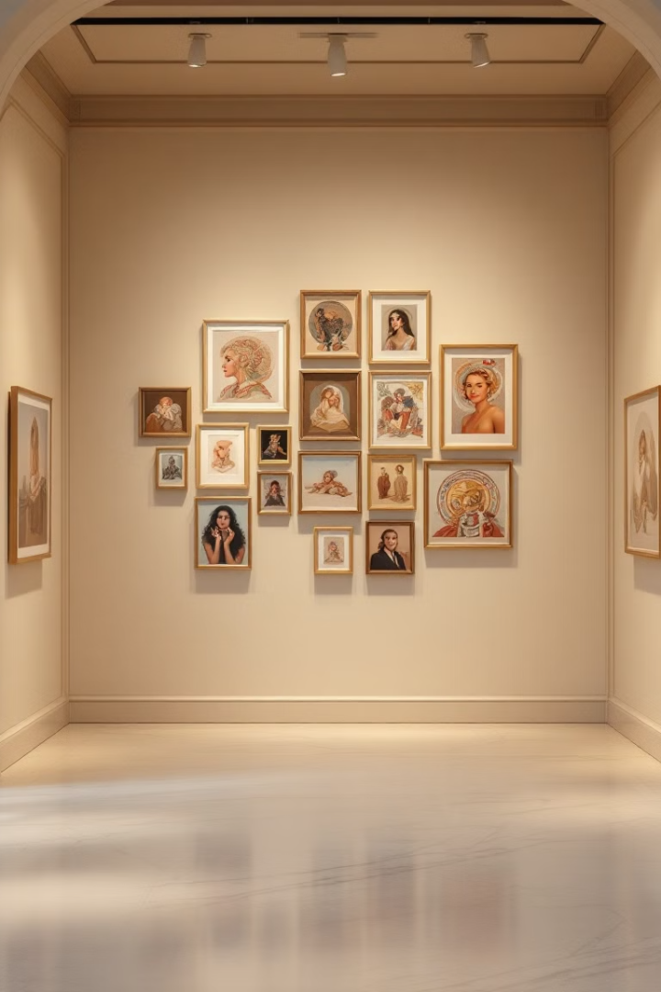
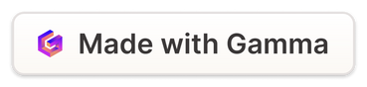
Clustering Wiki-Art using Self-Organizing Maps
Explore our AI project: clustering the Wikiart dataset using Self-Organizing Maps. Discover hidden patterns and relationships between artistic styles. We'll showcase the methodology and results. This project presents a novel approach to art analysis.

Slide 2
Introduction to Self-Organizing Maps (SOMs)
Dimensionality Reduction
Topology Preservation
Unsupervised Learning
Projects high-dimensional data onto a lower-dimensional grid.
Maintains the topological relationships of the input data.
Learns patterns without labeled data.
SOMs are unsupervised learning techniques. They produce a low-dimensional representation of sample data. Think of it as a neural network.

Slide 3




How SOMs Work: The Learning Process
Initialization
Training
Convergence
Randomly initialize the weight vectors for each node.
Find the Best Matching Unit (BMU) and update neighbors.
Repeat the training process until the map converges.
The learning process involves selecting a random input vector. Then adjust weight vectors to be more similar to the input vector. The learning rate and neighborhood radius decrease over time.

Slide 4

The SOM Grid: Structure and Function
Grid Structure
Node Representation
Neighborhood Function
Typically, a 2D grid where each node represents a cluster.
Each node contains a weight vector representing cluster characteristics.
Defines how much neighbors are updated during training.
The grid size influences the granularity of the clusters. Larger grids allow for more detailed representations. Each node contains a weight vector that represents the characteristics of the cluster it represents.

Slide 5
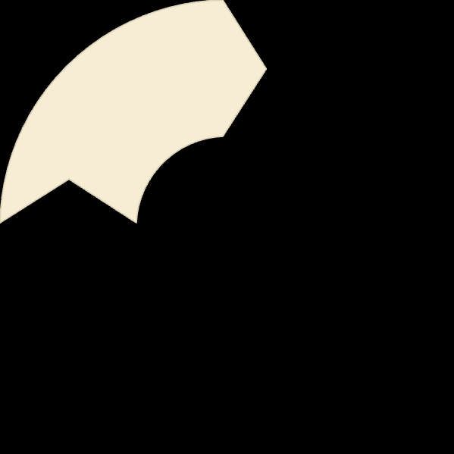
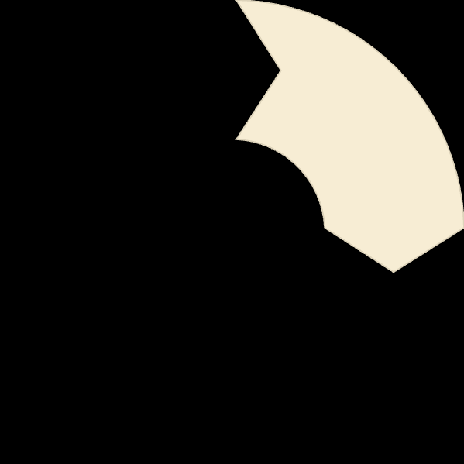
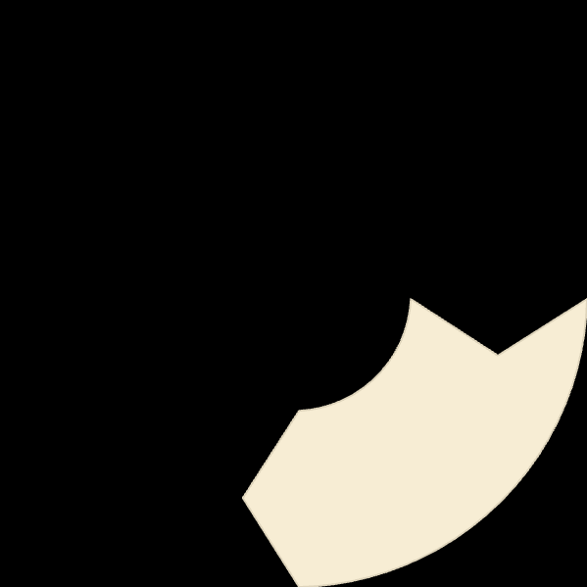
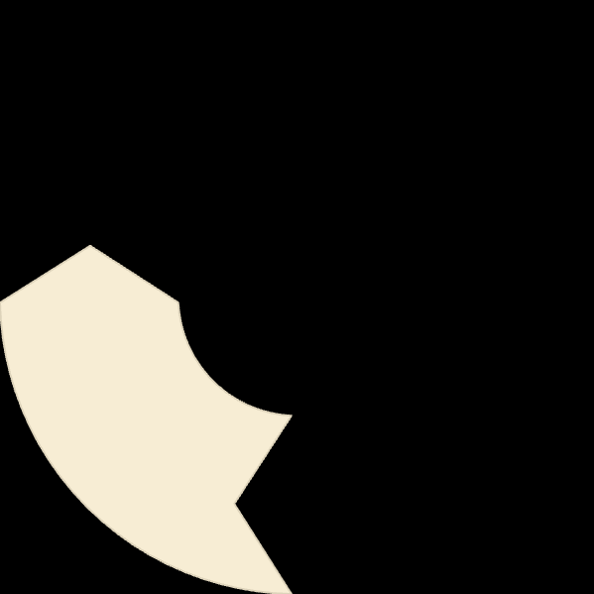
The U-Matrix: Visualizing Cluster Structure
1
Definition
Interpretation
2
4
Use Case
3
Visualization
The U-Matrix is a visualization technique that shows the distance between neighboring nodes. High values indicate boundaries, while low values indicate areas within clusters. It is typically represented as a heatmap.

Slide 6



Project: Clustering Wikiart Dataset
Wikiart: A collection of over 350,000 artworks.
Data Preprocessing: Extracting features from images.
Tools Used: Python, Scikit-learn, MinSom library
We extracted our images data from Wiki Art Dataset available in Kaggle. We also used data normalization. Sample images showcase the diversity of styles.

Slide 7
Implementation Details: Feature Extraction and SOM Training
1
Feature Extraction
2
SOM Training
3
Hyperparameter Tuning
Images were grayscaled, resized, flattened, and MinMax normalized before SOM training..
Trained a SOM with a 3x3 grid(i.e. 9 neurons)
Tuned grid size, learning rate, and neighborhood function and iterations.
We extracted features from the last fully connected layer and reduced dimensionality. A Gaussian neighborhood function was used. The SOM was trained for 1000 epochs.

Slide 8
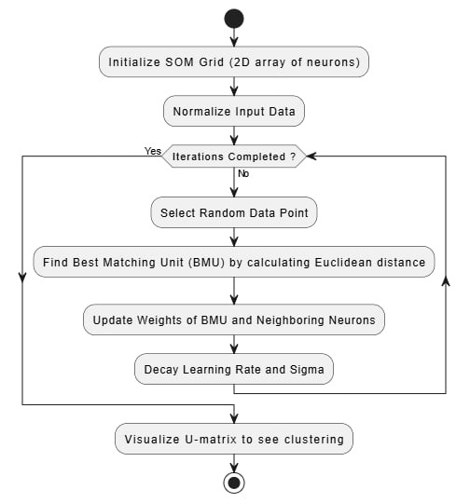
fig: flow-chart of SOM Clustering

Slide 9

SOM Initialization: Setting the Stage
SOM Grid Definition
Common Strategies
Map size, for example, 10x10 or 20x20. The grid size impacts cluster granularity.
sqrt(N), N = number of data points
Domain expertise to decide
Weight Initialization
Random vs. PCA-based approaches. Random draws from a uniform or normal distribution.

Slide 10
SOM Training: Euclidean Distance & BMU
1
Iterative Process
Epochs and Learning Rate decay over time.
2
Euclidean Distance
Formula: d(x, w) = sqrt(sum((xi - wi)^2)). x is input, w is weight of neuron.
3
Best Matching Unit (BMU)
Neuron with weight vector closest to the input.

Slide 11



SOM Training: Weight Update & Neighborhood
Weight Update Rule
w_new = w_old + learning_rate * influence * (x - w_old)
Learning rate decay
alpha(t) = alpha_0 * exp(-t / tau)
Neighborhood Function
influence(d) = exp(-d^2 / (2 * sigma^2)).

Slide 12
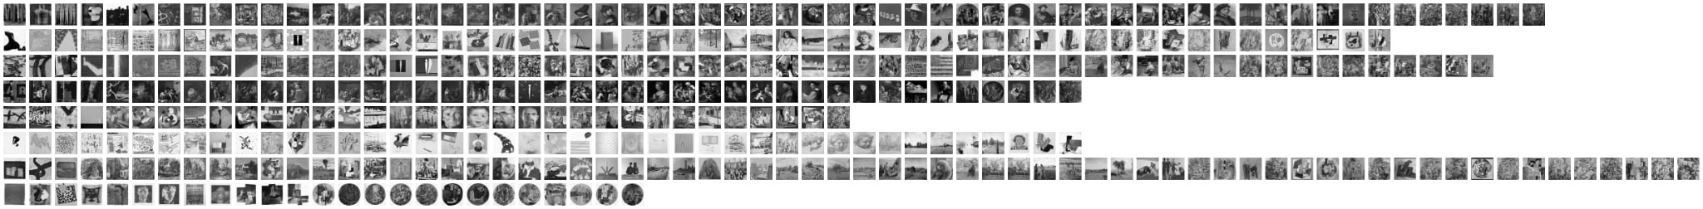
Clustering Result

Slide 13
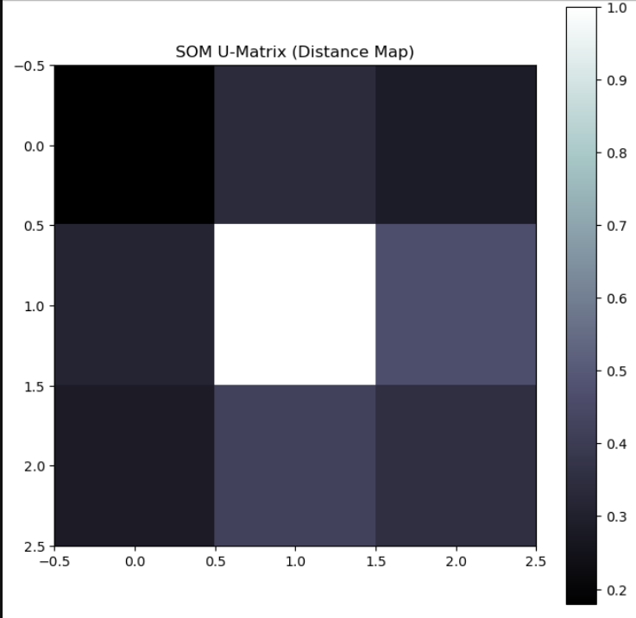
U-Matrix

Slide 14
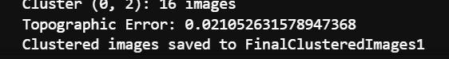
Model Performance Metric
The Topographic Error (TE) Metric in Self-Organizing Maps (SOM) measures how well the map preserves the topology of the input space. It quantifies how often the first-best (BMU) and second-best matching units for an input are not adjacent on the SOM grid.
TE=N1​i=1∑N​ei​
where:
N is the total number of input samples,
ei=1, if the BMU and second BMU are not adjacent, otherwise ei=0
TE =0, good topology preservation,
TE=1, distorted map, poor topology preservation

Slide 15
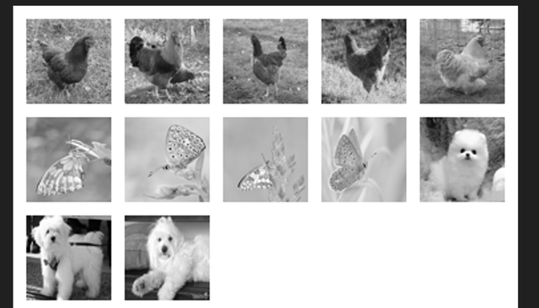
Testing On Other Datasets

Slide 16

Discussion: Insights and Applications
1
Insights
The SOM effectively captured the underlying structure.
2
Art Recommendation Systems
3
Content-Based Image Retrieval
4
Art Authentication
The U-Matrix provided valuable insights. Applications include art recommendation systems and art historical analysis. This can also be used for content-based image retrieval.

Slide 17
Conclusion and Future Work
1
Different Feature Extraction Techniques
2
Wiki Art Images Collection
3
Interactive Clustering Visualization
We successfully clustered the Wikiart dataset using SOMs. Future work involves exploring different feature extraction techniques. We can apply SOMs to other art datasets. We can also develop interactive visualization tools.

